Slide 1
Crowd Management
Explain crowd response
Apply FIST to crowd management
Determine solutions to crowd events

Slide 2
Historic Event
Who Concert

Slide 3
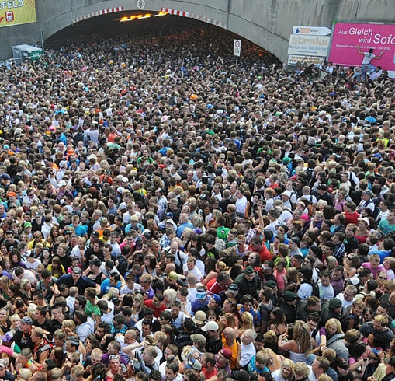
Crowd Management
Crowd control
Crowd management
Locations

Slide 4
Crowd Characteristics
Ambulatory: moving in and out of venue
Disability/movement limited: restrictions in movement
Cohesive/spectator: watching activities
Expressive/reveler: emotional release
Participatory: mass involvement in activity
Aggressive/hostile: disregarding authority
Demonstrator: some organization with leader
Escaping/trampling: attempting to flee
Dense/suffocating: individual movement lost
Rushing: purpose to obtain
Violent: Attacking

Slide 5
Crowd Factors
Organization: planned or spontaneous
Leadership: who is in charge
Cohesiveness: individuals bonds
Unity of purpose: goals
Common motives for action: responding to same threat
Emotional intensity: may not notice external cues
Volatility: boiling point
Individuality: how much self control and concern for others

Slide 6
Crowd Response
Panic
  Scarce resource
  Contagion
  Selfish
  Irrational behavior
Collective behavior
  Emergent norm theory
  Reorganization during emergency
  Social affiliation
  Group size

Slide 7
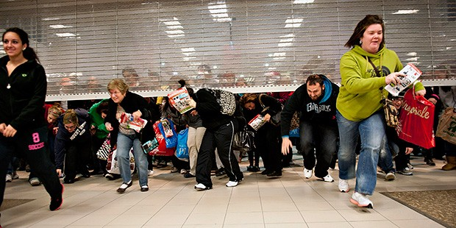
Risk Factors
Flight response
Craze
Festival seating
Escalator
Transportation

Slide 8
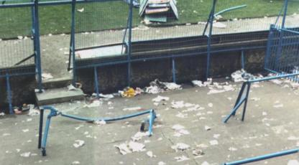
FIST
F
I
S
T

Slide 9
Solutions

